Slide 1
Individual Differences:
INTELLIGENCE

Slide 2
If someone could offer you a pill to make you more intelligent – would you take it?
How would your life change if you woke up one morning with a 20 point increase in your IQ?
Are you using the full extent of the intelligence you have?

Slide 3
Psychologists have been puzzling over what intelligence is for a long time.
Intelligence and intelligence tests have implications for our lives in terms of selection, advancement and exclusion in a range of domains.
Can intelligence be effectively measured? What do traditional intelligence tests measure? Is intelligence one thing or made up of many different abilities? Was Einstein’s intelligence of the same kind as Mark Twain’s, Leonardo Da Vinci’s or Helen Keller’s?

Slide 4
Who do you think is more intelligent –Aristotle or an undergraduate physics student whose understanding of the physical world is clearly superior?
Does intelligence ‘run in families’? Is it possible to compare the intelligence of different racial groups?

Slide 5
If you placed children from an urban, industrialized city (e.g.: metropolitans) into a remote forest community in central India, would they perform as well on local tests of judgement and reasoning as children of the same age from that indigenous community? Which group would we expect to perform better on conventional tests of spatial ability or verbal reasoning? If we do compare groups, do any differences have a genetic or cultural root?

Slide 6
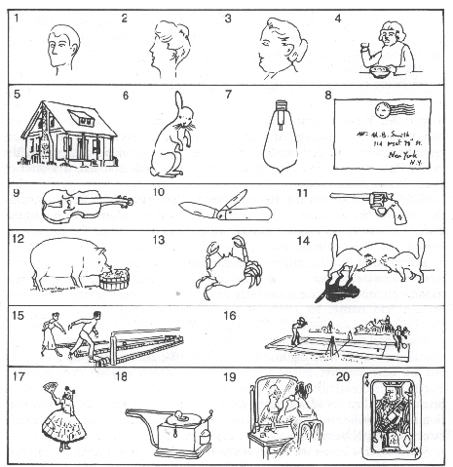
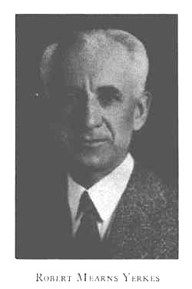
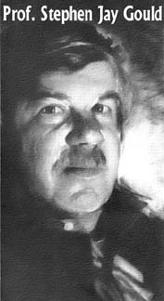
Yerkes vs Gould: A Nation of Morons
What is missing from the pictures?

Slide 7
Are we born with a fixed amount of intelligence? Are the same people who were smartest at school still smartest as adults? Are they the most successful? Is intelligence changed dramatically by education and culture?

Slide 8
Alpha bias - this occurs when the differences between men and women are exaggerated. Therefore, stereotypically male and female characteristics may be emphasised.
Beta bias -this occurs when the differences between men and women are minimised. This often happens when findings obtained from men are applied to women without additional validation.
Androcentrism - taking male thinking/behavior as normal, regarding female thinking/behavior as deviant, inferior, abnormal, ‘other’ when it is different.

Slide 9
Definition
Whatever intelligence test measure (Boring, 1923)
Inventiveness dependent upon comprehension and marked by purposefulness and self-corrective judgement (Binet, 1916; Stanley and Hopkins, 1978)
Aggregate or global capacity of the individual to act purposefully, think rationally and deal effectively with his environment (Wechsler, 1944)
Ability to undertake activities characterized by difficulty, complexity, abstractness, economy, adaptiveness to the goal, social value and emergency of originals and a maintenance of concentration thereof and a resistance to emotional forces (Stoddard, 1943)

Slide 10
Galton and individual differences
Francis Galton can be credited with the first systematic, scientific attempt to both understand and measure human intelligence.
Galton’s essential idea was that there are stable, biological differences in intelligence between people.
Galton considered intelligence to be a low-level property of our nervous system that we inherit from our parents.
He believed that individual differences in intelligence reflect differences in the efficiency of operation of simple neural processes.

Slide 11
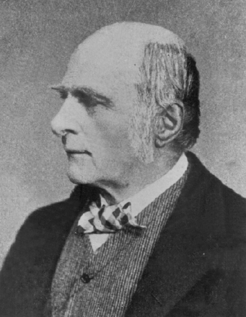
Francis Galton believed that biology has a large part to play in level of intelligence.

Slide 12
Normal distribution
Another of Galton’s contributions was to bring statistical understandings from the physical sciences to the study of psychology – particularly, the notion of normal distribution.
Galton noted that for any of our ‘natural gifts’ (physical, temperamental or intellectual) there will be an ‘average’ amount of that feature, to which most people approximate.
Then, as we consider scores increasingly higher or increasingly lower than that ‘average score’, there will be fewer and fewer people registering those scores.
Notes:
Studying the normal distribution of psychological characteristics
such as intelligence enables us to estimate attributes within
a group and to have a point of comparison for an individual’s
abilities. So, we expect that most people will approximate average
intelligence, and there will be a small but predictable number
of people of exceptionally high intelligence and an equally small
and predictable number will be severely mentally retarded.

Slide 13
Correlation
Galton also introduced the idea of ‘co-relation’ (Galton, 1888), or correlation, which is a measure of the extent to which two variables, such as weight and height, are related.
A correlation of +1 would reflect a perfect positive relationship between two variables.
A correlation of –1 would reveal a perfect negative relationship between two variables.

Slide 14
Early attempts to measure intelligence
In his Anthropometric Laboratory in London in the late nineteenth century, Galton attempted to measure a range of attributes that show individual variation.
Galton then compared these innovative measures of ‘intelligence’ to subjective estimates of the intellectual prowess of his participants based on their ‘reputation’ and eminence in the family tree.
Unfortunately, Galton’s empirical efforts were not successful.

Slide 15
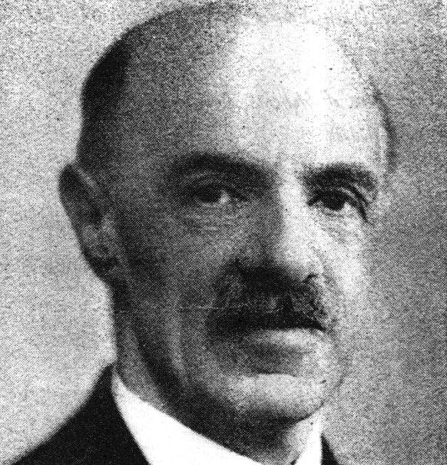
Charles Spearman’s Studies
Intelligence is a single ability
Factor Analysis: cluster of items that measure a common ability
Example: vocabulary, paragraph comprehension,
Grades in English classes, SAT verbal

Slide 16
G-Factor theory
Charles Spearman (1904) set out to estimate the intelligence of 24 children in his village school.
He discovered a relationship between each child’s performance in a number of domains (including teachers’ ratings of ‘cleverness’ and ratings by other students of their ‘common sense out of school’) and measures of their ability to discriminate light, weight and pitch.
Spearman concluded that there was a ‘general’ intelligence underlying performance on these very different tasks.

Slide 17
Spearman regarded general intelligence, or g, as a unitary, biological and inherited determinant of measurable intellectual differences.
S (specific) factor: abilities specific to a task
Different cognitive tasks and intellectual measures tend to be correlated (e.g.: relation of scores on an intelligence test)
Intelligence can be summed up as a single score (e.g.: IQ)
He likened g to mental energy – a limited resource available to all intellectual tasks.
So the idea was that individuals differ in general intelligence because they have different amounts of this mental energy.

Slide 18
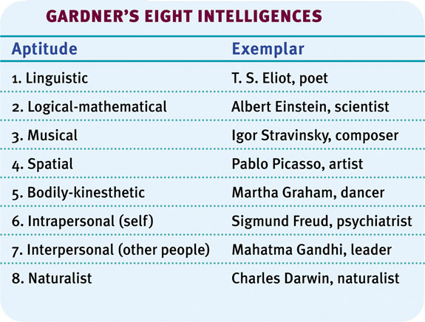
Howard Gardner
Gardner proposes eight types of intelligences (and speculates about a ninth one — existential intelligence. )
Notes:
Compare Gardner’s and Sternberg's theories of intelligence.
We have multiple intelligences, all independent of each other
Linguistic
logical-mathematical
spatial (these 1st 3 fall within bounds of qualities traditionally labeled as intelligence)
Existential intelligence is the ability to think about the question of life, death and existence.

Slide 19
Sternberg’s Triarchic Theory of Intelligence
Sternberg (1985, 1999, 2003)
Creative Intelligence: Intelligence that makes us adapt to novel situations, generate novel ideas
Analytical Intelligence: Intelligence that is assessed by intelligence tests.
Practical Intelligence: Intelligence that is required for everyday tasks (e.g. street smarts).

Slide 20
Stern’s formulation of IQ helped to drive a wedge between the two different approaches to studying intelligence – the individual differences method (concerned with IQ differences among peers) and the developmental method (concerned with changes in MA with CA).
This finally culminated in these different research approaches being split apart through the work of Jean Piaget.

Slide 21
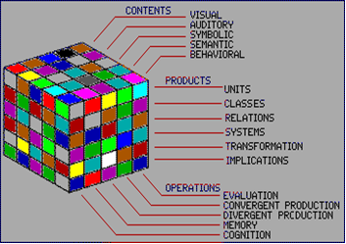
Multifactor theories
JP Guilford (1967): three dimensional theory: 5 operations x 6 products x 4 concepts

Slide 22
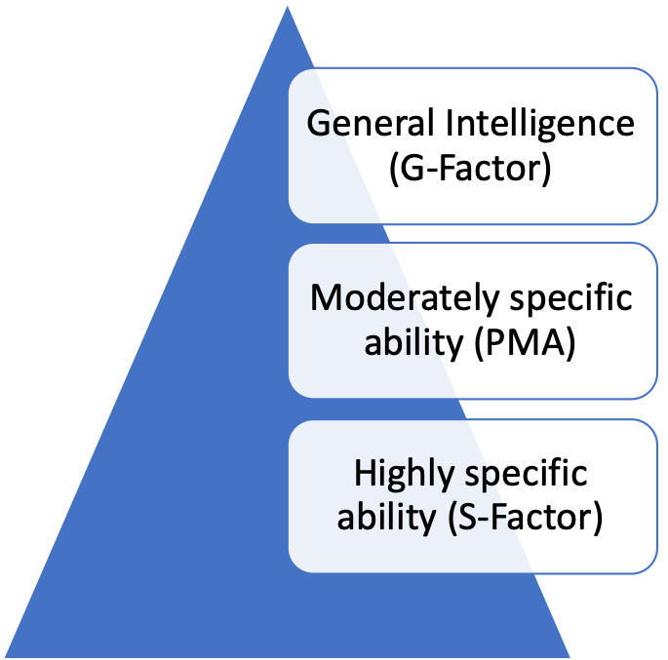
Hierarchical theory: Vernon (1950)

Slide 23
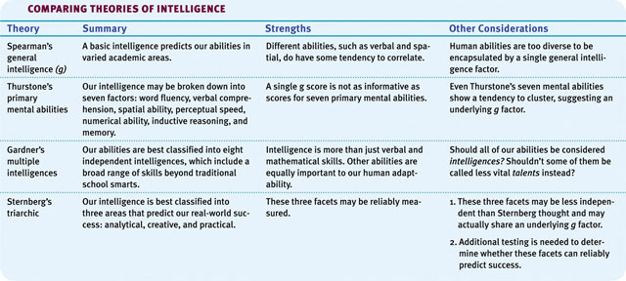
Theories: Comparison

Slide 24
Compare and contrast Spearman, Gardner, and Sternberg’s Theories of Intelligence. Which do you think is the best theory and why?
Notes:
Sternberg and Gardner’s studies are important in broadening our definition for intelligence…… in the workplace, the classroom, on the athletic field.

Slide 25
Process-oriented theories
Focus on intellectual processes: patterns of thinking people use when reasoning and problem solving
Piaget’s theory (1970): stage theory: adaptive process involving an interplay of biological maturation and interaction with the environment
Bruner’s Theory (1973): intellectual development relies on internal representations
Information-processing theories: components and metacomponents (Sternberg, 1984)

Slide 26
Horn and Cattell
Fluid (Gf ) intelligence: Horn and Cattell’s Gf is something akin to Spearman’s g, namely an overarching processing capacity that in turn contributes to Gc (see crystallized intelligence); the ability to learn new things and solve novel problems, irrespective of previous knowledge, education, or experience
Crystallized (Gc) intelligence: diverse skills and knowledge acquired across the lifespan; the knowledge, information, and skills that can be used to solve problems related to what one has already learned

Slide 27
Piaget and the importance of error
Piaget’s early career involved further developing Binet’s tests; his genius was to realize that errors on intelligence tests might be even more informative than the total test score used in Binet’s calculations of MA.
By contrast, at the same time psychometricians became further interested in developing better measures of individual differences in g (expressed in terms of test scores).

Slide 28
The intelligence landscape
Both Binet and Galton died in 1911.
In the century since, in terms of psychological practice, Binet’s conception of intelligence has dominated over Galton’s and Spearman’s, and has shaped the content of the current intelligence tests that are used in the Western world today.
On the other hand, the theoretical and empirical contribution of both Binet and Galton has been to sketch out the landscape for the ongoing debate about the nature of intelligence.

Slide 29
How is the intellect structured?
Intelligence as a general mental facility
If a random sample of participants take different types of cognitive tests, such as those in the Binet–Simon scale or the more recent Wechsler intelligence scales, those who are better than average on tests of vocabulary will generally be better than average at mechanical reasoning.
Positive manifold: the fact that the correlations between ability tests are all positive.

Slide 30
Underlying mental traits
How many (or how few) underlying traits are there, which explain most of the difference in scores we find on a whole battery of tests?
Factor analysis: a data reduction technique where relationships between a large number of variables can be reduced to a relationship among fewer hypothetical (i.e. latent) factors

Slide 31
The original factor solutions obtained by Spearman found a general factor of intelligence (g) and some specific factors.
Multifactor theories: Louis Leon Thurstone (1938) argued that, rather than a single general intelligence, there are seven ‘separate and unique’ primary mental abilities: word fluency, number facility, verbal comprehension, perceptual speed, associative memory, spatial visualization and inductive reasoning.

Slide 32
Current consensus
Carroll (Three stratum theory; 1993) and the American Psychological Association Task Force on Intelligence (1996) concluded:
There is now a strong consensus among psychometricians that the inclusion of a g factor leads to a better factor structure when attempting to interpret findings obtained from ability testing.
Notes:
This outcome is partly based on the fact that Thurstone’s
‘primary mental abilities’ themselves correlate with each other.
The same is true for Horn and Cattell’s crystallized and fluid
intelligence.

Slide 33
Daniel Goleman’s Emotional Intelligence
Emotional intelligence: ability to perceive emotions, to access and generate emotions so as to assist thought, to understand emotions and emotional knowledge, and to reflectively regulate emotions so as to promote emotional and intellectual growth.” (Mayer & Salovey, 1997); correlates positively with career, marriage, and parenting success.

Slide 34
Self-awareness: ability to recognize and understand personal moods and emotions and drives, as well as their effect on others
Self-regulation: ability to control or redirect disruptive impulses and moods, and the propensity to suspend judgment and to think before acting
Internal motivation: A passion to work for internal reasons that go beyond money and status
Empathy: ability to understand the emotional makeup of other people
Social skills: proficiency in managing relationships and building networks, and an ability to find common ground and build rapport

Slide 35
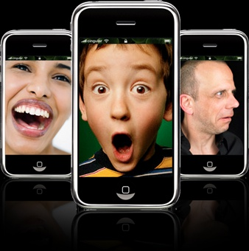
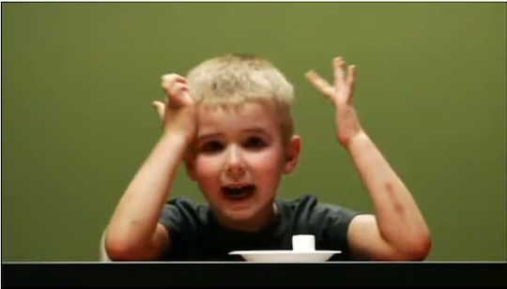
Emotion recognition
Mischel’s Marshmallow experiment
Notes:
ACROSS 69 cultures, we find emotional intelligence….
Emotion Recognitionl
Emotionally intelligent people can delay gratification:
Ex: Mischel’s marshmallow experiment on 4 year olds: you can have a marshmallow now or wait 15-20 minutes and have 2 – those that waited-
higher scores on SATs in HS
more socially competent
more personally effective and self assertive
more confident
more dependable
more trustworthy
Even after controlling for verbal aptitude ansd temperament, researchers find that 5 year olds who have most accurately discerened wemotions became 9-year olds who easily made friends

Slide 36
Should intelligence apply to emotions?
Studies show general intelligence DOES matter
Gardner: General intelligence is necessary to get your foot through the door, determines job performance and occupational status, predicts a longer life span

Slide 37
Non-unitary theories of intelligence
Gardner’s theory of multiple intelligences
Ever since Thurstone (1939), there has been a long series of challengers to Spearman’s unitary conception of intelligence.
Gardner believes that, in defining intelligence, we typically only focus on a narrow range of logico-mathematical abilities (his theory of multiple intelligences accounts for the diverse range of important adult capacities by considering a diverse range of abilities).
Multiple intelligences: Gardner’s theory that there are many autonomous intelligences including linguistic, musical, logical–mathematical, spatial, bodily-kinaesthetic, personal, naturalist and spiritualist.
Notes:
Each is manifested, suggests Gardner, in culturally relevant ‘intelligent’ behaviours, with normal adults having differing profiles of relative strengths and weaknesses across these intelligences.

Slide 38
The idea that there is more to intelligence than g alone is now generally accepted.
The challenge for the future is to develop a theory that makes g compatible with the observed degree of specificity in intellectual functioning that has been outlined as evidence by Gardner.

Slide 39
A hierarchical structure for intelligence
Sternberg (1984, 1985) also proposed a non-unitary theory – the triarchic theory of intelligence.
Like Gardner, he proposes several types of intelligence: analytical intelligence (which approximates the traditional notion of g); creative intelligence (which involves insight, synthesis and the ability to respond to novel situations); and practical intelligence (which involves the ability to solve real-life problems).

Slide 40
But in his theory, Sternberg attempts to go beyond this to explain how these intelligences work.
He suggests that each kind of intelligence involves a control hierarchy of cognitive components that contribute to our ‘mental self-management’ – these include a) performance components, b) knowledge acquisition components and c) metacomponents.
Notes:
Cognitive components – basic information-processing routines
(e.g. encoding, response selection) which underpin task performance

Slide 41
Although Sternberg has written extensively on his theory, it reads more like a re-statement of how intelligence is manifested rather than an explanation of it.
Furthermore, recent reviews of the theoretical and empirical support for the theory do not support the notion that creative or practical intelligences are as important as analytical intelligence (i.e. an approximation of g) in predicting life success (Brody, 2003; Gottfriedson, 2003).

Slide 42
Integrating current issues
A century after Galton and Binet, we are now making progress in developing new models that draw together some of the apparent contradictions of earlier research.
And we have moved some way towards understanding both individual differences and developmental change in ‘normal’ intelligence, as well as in exceptional intellectual populations.
Work in the field of intelligence has never been more vibrant at both the level of theory development and at the level of applied research and practice.

Slide 43
Intelligence and Creativity
Creativity is the ability to produce ideas that are both novel and valuable. It correlates slightly with intelligence.
Expertise: A well-developed knowledge base.
Imaginative Thinking: The ability to see things in novel ways.
Adventuresome Personality: A personality that seeks new experiences rather than following the pack.
Intrinsic Motivation: A motivation to be creative from within.
A Creative Environment: A creative and supportive environment allows creativity to bloom.

Slide 44
Identify the factors associated with creativity, and describe the relationship between creativity and intelligence.

Slide 45
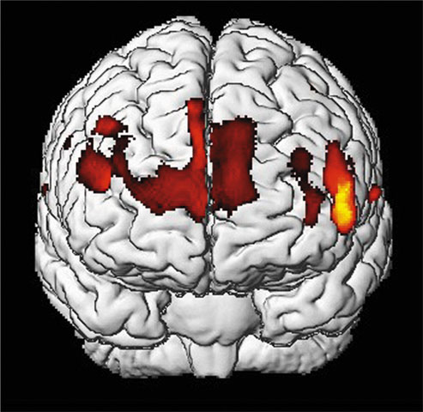
Is Intelligence Neurologically Measurable?
Recent Studies indicate some correlation (about +.40) between brain size and intelligence.
Gray matter concentration in people with high intelligence.
Notes:
Describe the relationship between intelligence and brain anatomy.
Several studies report a positive correlation (+.40) between brain size and intelligence score. As adults age, brain size and nonverbal intelligence test scores fall in concert.
Other studies suggest that highly educated people die with more synapses, (Albert Einstein, for example) very intelligent people have greater neural plasticity
Larger brain size MAY enable greater intelligence, but it is also possible that greater intelligence elads to experiences that exercise the brain and build more connections, increasing its size

Slide 46
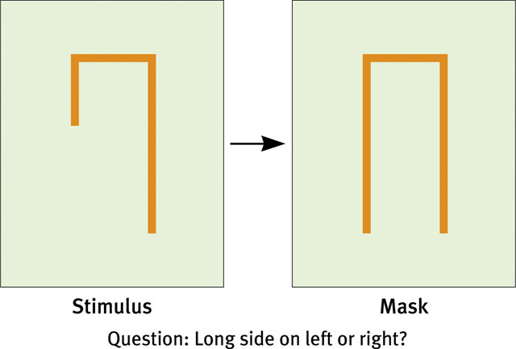
Brain Function: Intelligence tests and reaction time
People with higher intelligence respond correctly and quickly to
the above question.

Slide 47
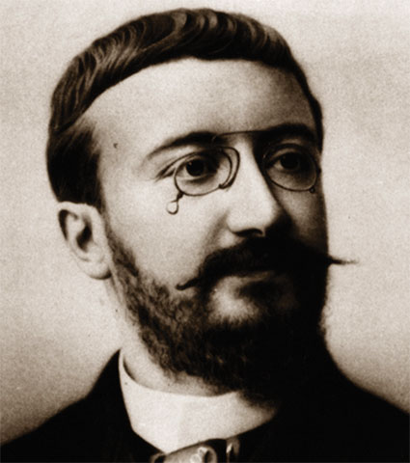
Measuring Intelligence
Intelligence testing: a method for assessing an individual’s mental aptitudes and comparing them with others
Alfred Binet: predictor intelligence testing
developed questions that would predict children’s future progress
Mental Age: Intelligence
Increases as we age
Average Mental Age of 10 year old= 10

Slide 48
Binet and developmental changes
In contrast to Galton and Spearman, Alfred Binet focused on the universalities of human intellect.
He proposed that we all pass through certain developmental stages, and that to understand these stages we should consider the ‘higher faculties’ of the mind rather than ‘low-level’ neural processing.

Slide 49
The first intelligence tests
Binet set about finding a way to construct tests with objectively verifiable scales of difficulty that could measure rates of development in ‘higher mental processes’.
Binet’s technique for constructing the first test was based on an important insight: whatever intelligence is, we can be sure that it changes (develops) with age.

Slide 50
The first intelligence test was based on the central idea that the age at which the ‘average child’ can succeed at a particular problem is an indication of the difficulty of that problem.
Binet and his associate Théodore Simon used a range of tasks in their first intelligence tests.

Slide 51
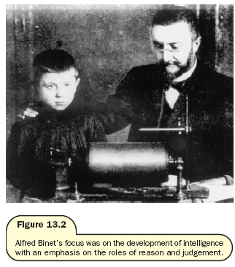
Alfred Binet’s focus was on the role of development of intelligence with an emphasis on the roles of reason and judgement.

Slide 52
Binet was also the first psychologist to specify that such tests must be:
  administered and scored in a careful and standardized manner if comparisons between children’s performance are to be valid and reliable
  presented in the same order to all children and in order of increasing difficulty so that each child can pass as many tests as possible; and 3. administered in a one-to-one setting and only where the examiner has first established a friendly rapport with the child.
Psychologists still adhere to these very important principles of testing today.

Slide 53
IQ and the birth of psychometrics
Later, Binet used the idea of the average age at which a task was mastered to derive a child’s mental age – a radically new concept.
Mental age (MA) is equivalent to the chronological age (CA) for which any test score would represent average performance.
Use of Age norms: represent typical performance or some aspect of development for children within a particular age group
So a child scoring better than the average child of his age would have a higher MA than CA, and a child scoring lower than average would have a lower MA than CA.

Slide 54
It took one short step, by William Stern (1914), to derive an index of differences in intelligence within ages.
The resulting intelligence quotient, or IQ, was calculated using the classical formula, IQ = MA/CA × 100.
Psychometrics, the standardized measurement of human abilities, was thereby born.

Slide 55
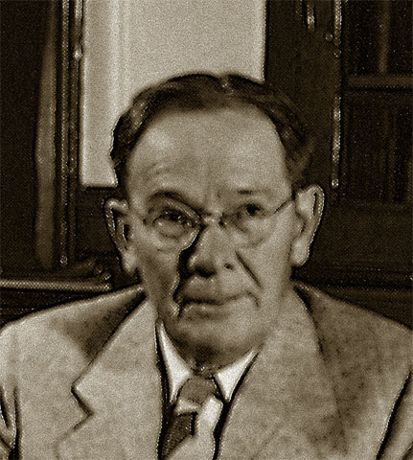
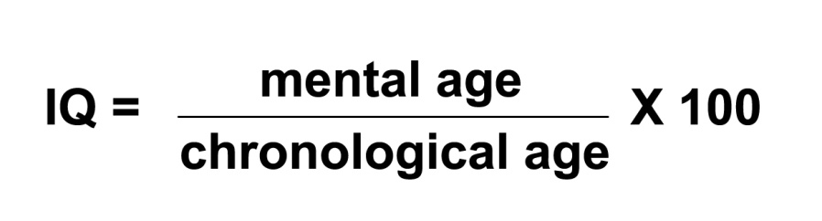
Lewis Terman
Stanford-Binet Test: formula of Intelligence Quotient (IQ)

Slide 56
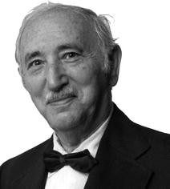
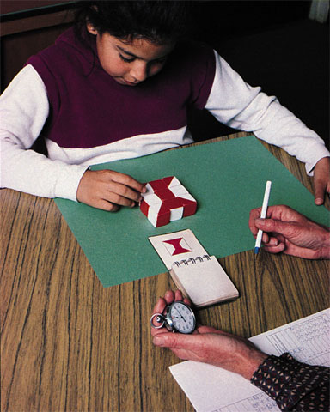
David Wechsler
Wechsler developed the Wechsler Adult Intelligence Scale (WAIS) and later the Wechsler Intelligence Scale for Children (WISC), an intelligence test for preschoolers.

Slide 57
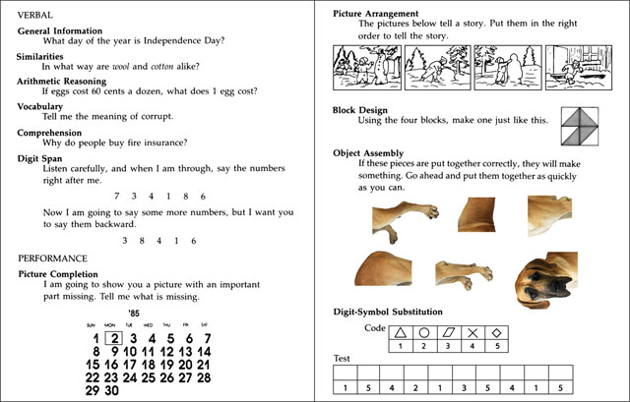

Slide 58
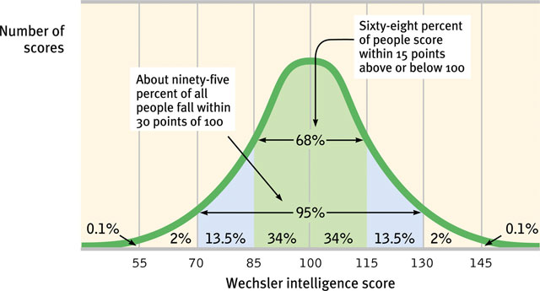
Normal Curve: Standardized tests establish a normal distribution of scores on a tested population in a bell-shaped pattern called the normal curve
Variance- degree to which scores differ from each other
Standard deviation: degree to which scores differ from the mean

Slide 59
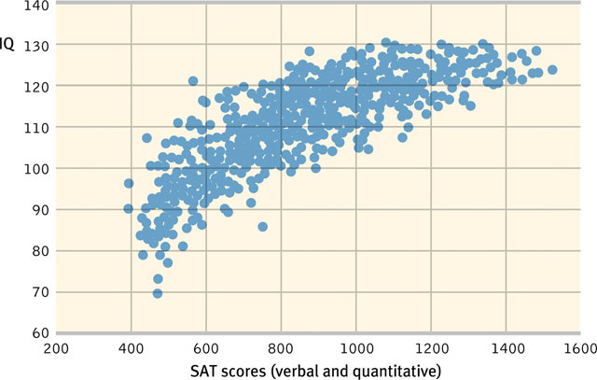
Aptitude and Achievement Tests
Aptitude tests are intended to predict your ability to learn a new skill. Example: pilot exam, college entrance exam, driving test
Achievement tests are intended to reflect what you have already learned. Examples: unit exams

Slide 60
Aptitude or Achievement?
SAT’s
Aptitude
GPA
Achievement
Driver’s Test
Both

Slide 61
Principles of Test Construction
For a psychological test to be acceptable it must fulfill the following three criteria:
Standardization
Reliability
Validity

Slide 62
Standardization:
1) administering the test to a representative sample of future test takers
2) Testing and scoring uniformly for all test-takers
3) Basis for meaningful comparison

Slide 63
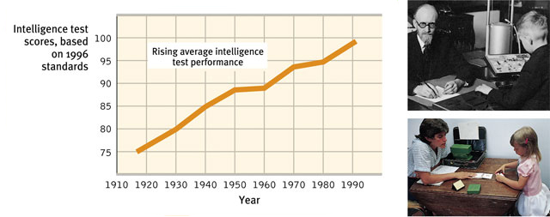
Flynn Effect
In the past 60 years, intelligence scores have risen steadily by an average of 27 points.
Tests must be re-standardized over time
Notes:
Flynn effect- several theories to explain, may be due to:
Better nutrition
Better education
More stimulating environments
More parental investment
Better genes

Slide 64
Reliability: Extent to which a test yields consistent results
Test-Retest Reliability: using the same test on two occasions to measure consistency
Validity: test refers to what the test is supposed to measure or predict.
Content Validity: Refers to the extent a test measures a particular behavior or trait.
Criterion validity:
  Predictive Validity: Refers to the function of a test in predicting a particular behavior or trait.
  Concurrent validity

Slide 65
The Dynamics of Intelligence
Does intelligence remain stable over a lifetime or does it change? Are individuals on the two extremes of the intelligence scale really that different?

Slide 66
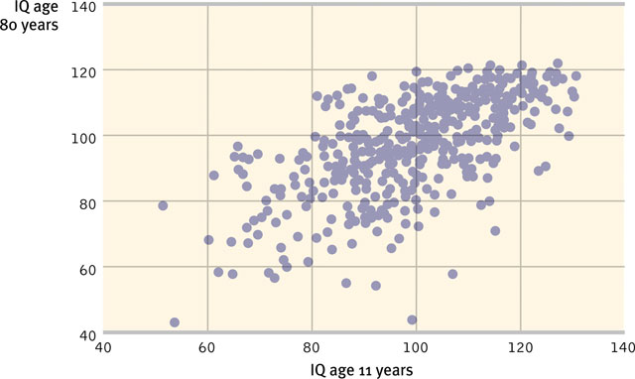
Intelligence scores become stable after about seven years of age. In numerous studies, stability of intelligence scores have been determined (Angoff, 1988; Deary et al., 2004).

Slide 67
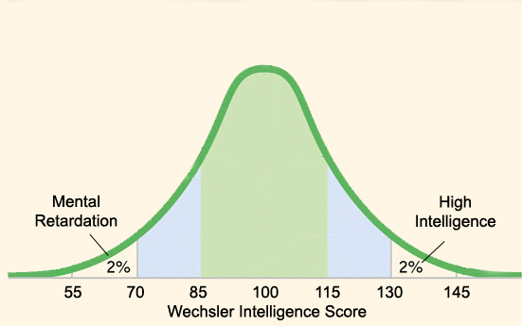
A valid intelligence test divides two groups of people into two extremes: the mentally retarded (IQ 70 and below) and individuals with high intelligence (IQ 135). These two groups are significantly different.

Slide 68
Mental Retardation
The American Association on Mental Retardation gives the following definition:
Mental retardation (MR) refers to substantial limitations in present functioning. It starts before age 18 and is characterized by significantly sub-average intellectual functioning, existing concurrently with related limitations in two or more of the following applicable adaptive skill areas: communication; self-care; home living; social skills; community use; self-direction; health and safety; functional academics; leisure; work

Slide 69
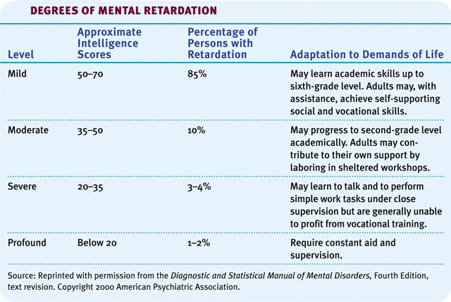

Slide 70
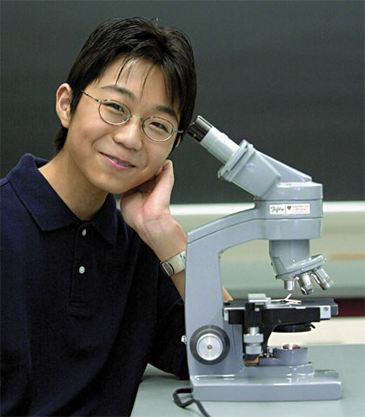
High Intelligence
Contrary to popular belief, people with high intelligence test scores tend to be healthy, well adjusted, and unusually successful academically.

Slide 71
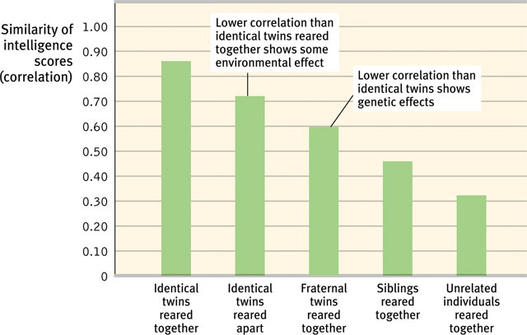
Genetic and Environmental Influences on Intelligence
Is intelligence due to genetics or environment?

Slide 72
Environmental influences
Studies of twins and adopted children also show the following:
Fraternal twins raised together tend to show similarity in intelligence scores.
Identical twins raised apart show slightly less similarity in their intelligence scores.

Slide 73
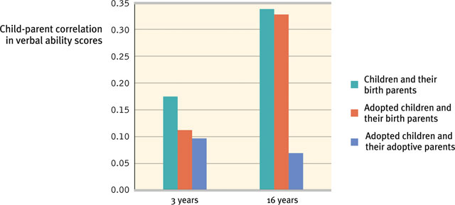
Adoption studies
Adopted children show a marginal correlation in verbal ability to their adopted parents.

Slide 74
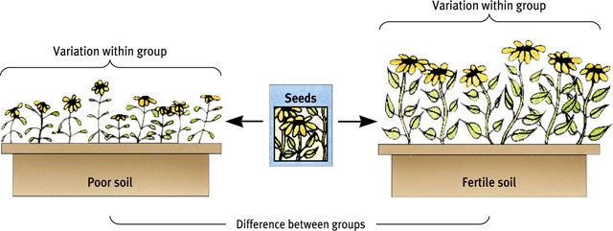
Environmental studies
Differences in intelligence among these groups are largely environmental, as if one environment is more fertile in developing these abilities than another.

Slide 75
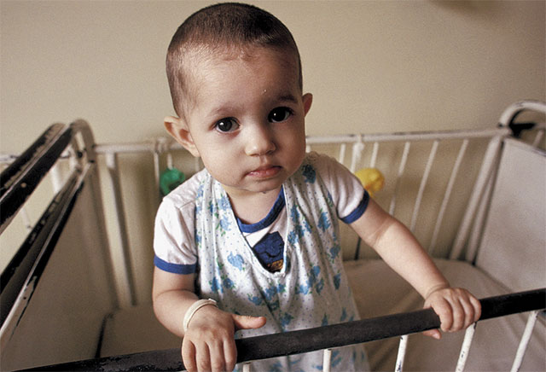
Early intervention effects
Pseudo-retardation; early neglect from caregivers leads children to develop a lack of personal control over the environment, and it impoverishes their intelligence
Romanian orphans with minimal
human interaction are delayed in their development.

Slide 76
Ethnic similarities and differences
Racial groups differ in their average intelligence scores.
High-scoring people (and groups) are more likely to attain high levels of education and income.

Slide 77
1. Paul takes a test in the army to see if he would make a good pilot. Such a test is
A) A standardized test D. An achievement test
B) An aptitude test E) A biased Test
C) An intelligence test
2. An 8-year-old who responded to the original Stanford-Binet with the proficiency typical of an average 10-year-old was said to have an IQ of:
A) 80 B) 100 C) 120 D) 125 E) 150
3. A measure of intelligence based on head size is likely to have a ________ level of reliability and a ________ level of validity.
A) low; low B) low; high C) high; low D) high; high
4. Aptitude tests are to ________ as achievement tests are to ________.
A) current interests; past competence
B) past competence; current interests
C) current competence; future performance
D) future performance; current competence
5. When Jonathan was told that he correctly answered 80 percent of the items on a mathematical achievement test, he asked how his performance compared with that of the average test taker. Jonathan’s concern was directly related to the issue of:
A) standardization B) predictive validity C) reliability D) content validity

Slide 78
Environment and Intelligence
Races are remarkably alike genetically.
Race is a social category.
Asian students outperform North American students on math achievement and aptitude tests.
Today’s better prepared populations would outperform populations of the 1930s on intelligence tests.
White and black infants tend to score equally well on tests predicting future intelligence.
Different ethnic groups have experienced periods of remarkable achievement in different eras.

Slide 79
Gender similarities and differences
1. Girls are better spellers
2. Girls are verbally fluent and have large vocabularies
3. Girls are better at locating objects
4. Girls are more sensitive to touch, taste, and color
5. Boys outnumber girls in counts of underachievement
6. Boys outperform girls at math problem solving, but under perform at math computation
7. Women detect emotions more easily than men do

Slide 80
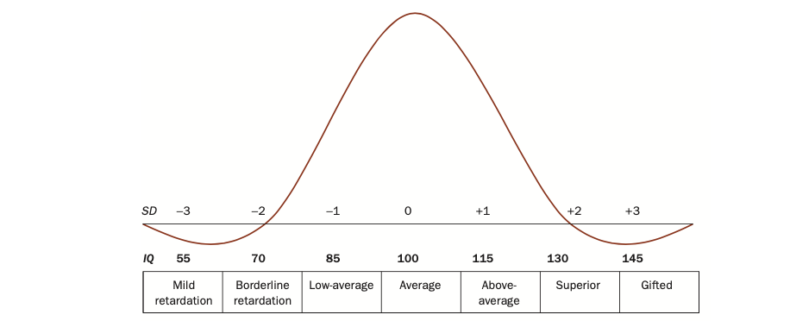

Slide 81
Terms to know:
Genotype: our genetic complement, coded in DNA, that we inherit from our parents.
Phenotype: the expression of our genes in behavioural traits that we can measure.

Slide 82
Heritability is a statistic that represents the proportion of phenotypic variance that is due to genetic differences – that is, the extent to which differences in measured intelligence are due to genetic differences.
The maximum heritability is 1.0 (100 per cent of the difference is inherited) and the minimum is 0 (none of the difference is due to genetic differences).

Slide 83
The influence of environment
There are differences between families (levels of income, parental rearing style, number of books in the home, etc.) which make children raised in a particular home more similar to each other than to children reared in a different home.
This source of differences is often called the effect of the shared environment.

Slide 84
The second kind of environmental influence are differences within the same family (in birth-order, children’s friends, school teachers, etc.).
These effects make children in the same family different from each other and are referred to as non-shared environment effects.

Slide 85
Do we inherit our IQ?
Studies on the influence of genetic differences on intelligence are in broad agreement.
Intelligence, as measured by IQ tests, has a substantial heritability.

Slide 86
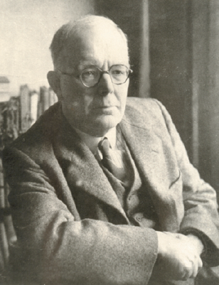
Through his study of twins, Sir Cyril Burt concluded that intelligence is largely hereditary

Slide 87
Estimates of heritability vary between 80 per cent (Bouchard et al., 1991) and 50 per cent (Plomin 1990).
So even the more conservative estimates argue that genetic differences are far from trivial – they are at least as important as environmental differences, and maybe more so.

Slide 88
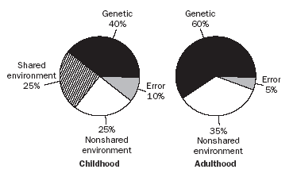
The proportion of variance in general intelligence accounted for by genes increases with development, while that accounted for by shared environment decreases

Slide 89
The importance of life events
Over the whole lifespan it seems that the most important environmental differences are those that are non-shared and unique to the individual concerned (that is, they are not shared by members of the same family).
Irrespective of our shared environment, most of us find ways ultimately to realize our genetic potential, depending on the effects of our idiosyncratic life events (i.e. nonshared environment).

Slide 90
Finding the IQ gene(s)
Most recently great excitement has surrounded the methodology of quantitative trait loci (QTL), which attempts to associate particular genes with specific behaviours.
The general consensus is that intelligence must be polygenic, which means that many genes contribute in an additive or dose-related fashion to IQ differences.
If this is right, current QTL methods have very little chance of discovering the individual genes that each contribute only a relatively small proportion to the overall genetic effect.

